Slide 1




GAN Dissection: Visualizing and Understanding Generative Adversarial Networks
David Bau, Jun-Yan Zhu, Hendrik Strobelt, Bolei Zhou, Joshua B. Tenenbaum, William T. Freeman, Antonio Torralba
Charles (Tripp) Isbell
Lalithya Kuntamukkala

Slide 2
Objective
GANs are able to produce realistic images.
Applications - visual recognition, image manipulation, video prediction.
Research into interpreting and understanding generative models is a new area.
This method seeks a semantic understanding of the generator’s internal representations
Church
Living room
Restaurant
256x256 images synthesized by a Progressive GAN [Karras, et al 2017]

Slide 3
Objective
How does it represent the visuals internally
How do different architectures affect GAN learning
What causes the artifacts in GAN results?
What knowledge does a GAN need to learn
What causes mistakes
Why does a GAN work better than the other
How are objects represented in the generator?
Does the generator simply memorize pixel patterns to produce objects? Or does it learn internal variables corresponding to objects?
If it does contain variables (e.g. for doors or trees), do they cause the generation of those objects, or do they merely correlate?
How are relationships between different objects represented?

Slide 4
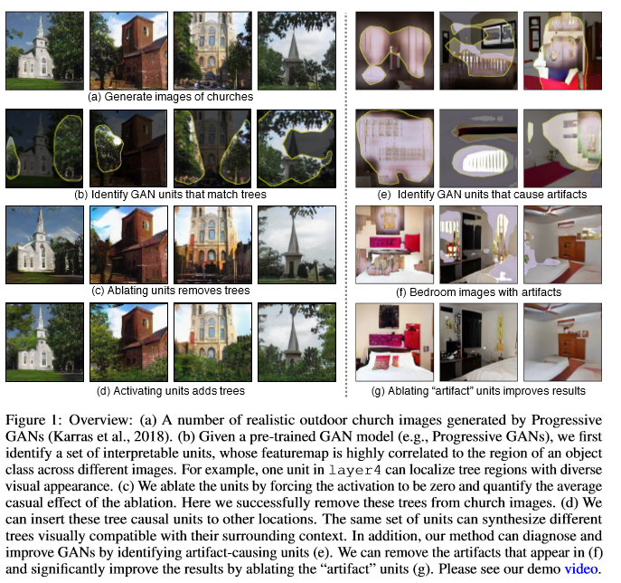
What does this paper do?
Present an analytical framework to visualize and understand GANs at the unit-, object-, and scene-level.
Understand how a GAN represents structure and order.
Identify a group of interpretable units that are related to object concepts using a segmentation-based network
Intervene within the network to identify sets of units that cause a type of objects to disappear or appear.
Quantify the effect of interpretable units by measuring ability of interventions to control objects in the output.
Examine the contextual relationship between the units and surroundings by inserting the discovered object concepts into new images.

Slide 5
Which units correlate to an object class?
Notes:
To understand the role of a neuron, we begin by asking about correlation.
We want to know “which convolutional units correlate to an object class that humans would recognize?”

Slide 6
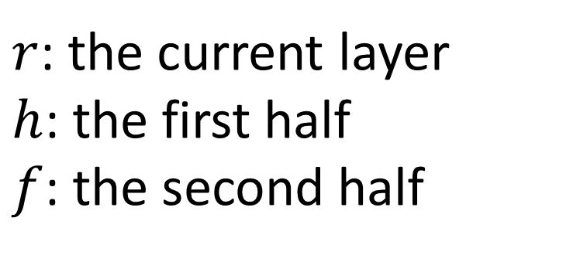
Which units correlate to an object class?
$r$: the current layer
$h$: the first half
$f$: the second half
Notes:
We start by sampling a bunch of random z, and running the generator.
Since we’re interested in the internal neurons, we split the generator at a specific layer, and examine the intermediate outputs of that layer.
The paper uses “r” to denote the representation (the intermediate output) of the layer of interest.

Slide 7
Which units correlate to an object class?
Notes:
Completing the generator will generate a synthetic image (a generated outdoor church is shown here).

Slide 8
Which units correlate to an object class?
Notes:
The representation r will contain the output of every neuron of a layer.
Since this is a fully convolutional net, the individual neurons of the layer are organized into convolutional channels, where each pixel of a channel behaves according to the same local rules as every other pixel in the channel. So to understand a neuron, we really want to understand a single convolutional channel.
We call a convolutional channel a “unit”. One unit of the representation forms a heat map over the image.

Slide 9
Which units correlate to an object class?
Notes:
To test correlations to human-understandable concepts, we use a pretrained segmentation network to label pixels in the generated image.
Here all the tree pixels are labeled.

Slide 10
Which units correlate to an object class?
Notes:
Then we ask “how well does a single representation unit solve the same problem as a segmentation network?”
To use a single unit to solve a segmentation, we just upsample the representation unit, and cuts the response at a fixed threshold.
(How to upsample? Just bilinear interpolation. Which threshold? It’s possible to do the analysis by just choosing a naïve fixed threshold such as the top 1%ile level for the unit, but the paper makes a slightly different choice that maximizes relative mutual information between the feature and the segmentation label being matched.)

Slide 11
Which units correlate to an object class?
Notes:
Then each unit is a little segmentation solution. A standard way to measure segmentation accuracy is IoU, so we use that to quantify how well the network is at solving each segmentation problem.
To be precise, we measure the IoU between the segmentation network (treating it as a ground truth) and the upsampled thresholded unit.
Examining every unit and every segmentation concept, we can identify units that seem to correlate with an object class. For example, this unit seems to indicate trees.

Slide 12
Which units correlate to an object class?
Church samples
Unit #119
Tree
Unit #32
Dome
Notes:
The IoU scores can be pretty good (e.g., > 0.3 for the best units), especially considering that the units emerge from a completely unsupervised training process.
This is pretty suggestive that the network is not just memorizing.
It suggests that the network is actually learning the structure of a scene and how it is made of different types of objects.

Slide 13
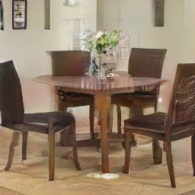
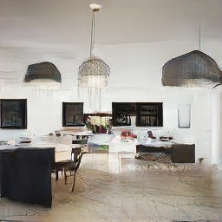
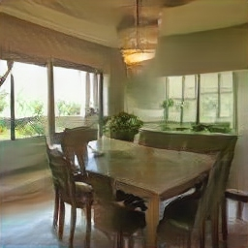
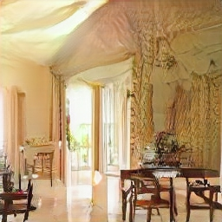
Which units correlate to an object class?
Dining room samples
Unit #139
Window
Unit #65
Table
Notes:
The effect doesn’t just occur for churches. Here are some examples from a dining room GAN. Tables, windows, chandeliers, etc – these all seem to be represented as distinct units.
On the other hand, it is not 1:1. There are a few dozen units that all correlate with dining room tables in this GAN.
This leads to the next question: since correlation is not the same as causation, can we tell what a neuron is really for?

Slide 14
Which units cause an object class?
Notes:
So we want to ask next, which neurons actually _cause_ a tree or a door or window.

Slide 15
Which units cause an object class?
Notes:
We can test this by choosing a set of units at a layer that we suspect are causal.
We will choose about 20 units that all correlate with the concept we want to test.

Slide 16
Which units cause an object class?
Notes:
Then we can test causality by forcing all 20 of those units off.
We literally reach into the network and just force the output of those neurons to zero, ignoring what they normally output, and then we continue the rest of the computation and generate the image.
We get a synthesized image like this.

Slide 17
Which units cause an object class?
Notes:
Then we analyze the synthesized image to see what object classes appear. Here we zeroed a bunch of units correlating with trees, and we can see, both qualitatively and according to the segmentation network, that there are fewer tree pixels in the output image.

Slide 18
Which units cause an object class?
Notes:
The second intervention we can do is that we can force those same units on.

Slide 19
Which units cause an object class?
Notes:
When we do that, in this case, trees now appear everywhere.

Slide 20
Which units cause an object class?
Notes:
The difference in the amount of trees in the output when our variables are forced on, and when they are forced off, is called the “Causal Effect.”
We can test this over a large sample of images and quantify the results as the “average causal effect”.
As a detail, we can also force a single neuron on and off (that is, just one pixel of the featuremap) and measure its local effects as well.

Slide 21
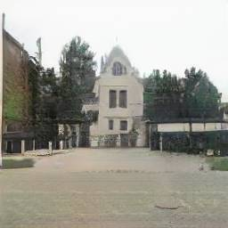
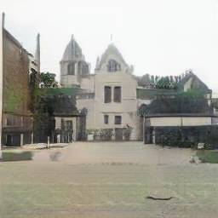
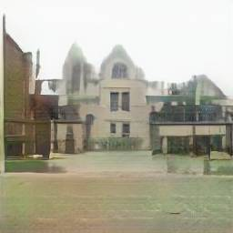
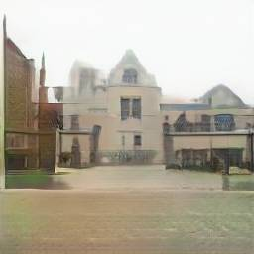
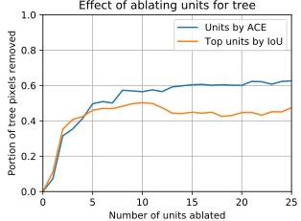

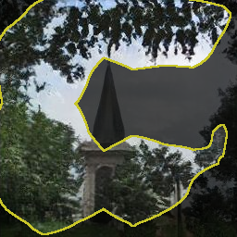
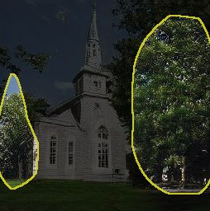

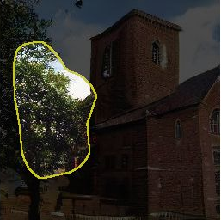
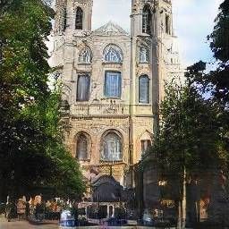
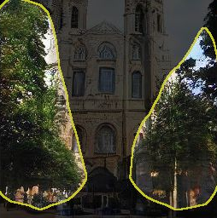

Removing or Adding Units
0
5
10
20
Number of tree units ablated
Notes:
Do neurons actually have causal effects?
Yes they do. The causal effects are stronger if you take sets of neurons together rather than individual ones. Here the causal effects are shown of zeroing 5, 10, and 20 units that are most highly correlated to trees. At the right the effects are quantified by average causal effect.
There are a couple ways we could choose the units to examine for causal effects. We could just look at the most correlated units (that’s the orange line). Or we could run an optimization to identify the units that are actually most causal (that’s the blue line). So if we’re being careful, we can notice that a few of the correlated units are not as important for causal effects as others, and the set of units can be chosen more carefully for stronger causal effects.

Slide 22
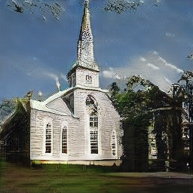
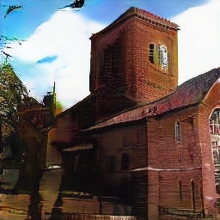
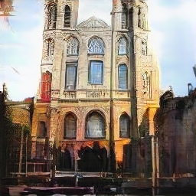
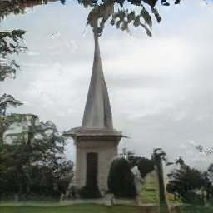
Removing or Adding Units
0
5
10
20
Number of tree units ablated
Notes:
The effects can be used to remove trees from images, as shown in these examples.

Slide 23


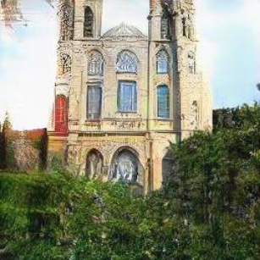

Removing or Adding Units
0
5
10
20
Number of tree units ablated
Notes:
The neurons can also be turned on to cause the effect of adding more trees to images, as shown in these examples.
In summary - these are the two methods the paper uses for understanding the individual neurons in a network.
Dissection, which looks for correlations between individual units and semantic concepts
Intervention, which measures the effect of turning on and off a group of units on the concepts in the output.

Slide 24

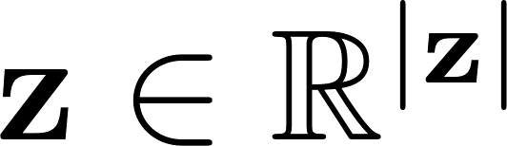
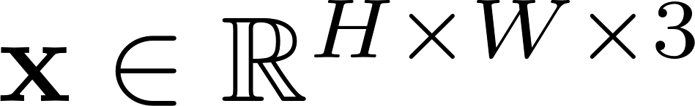

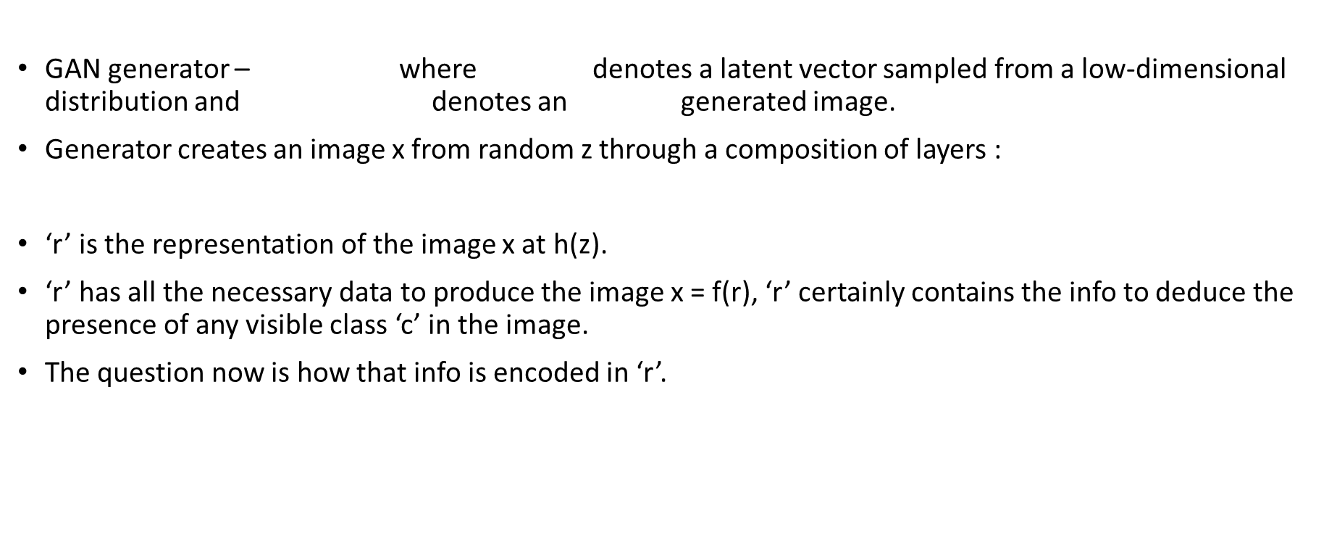
Method details
GAN generator – where denotes a latent vector sampled from a low-dimensional distribution and x $∈$ R ^{(H x W x 3)} denotes an H x W generated image.
Generator creates an image x from random z through a composition of layers :
r = h(z), x = f(r) = f(h(z)) = G(z)
‘r’ is the representation of the image x at h(z).
‘r’ has all the necessary data to produce the image x = f(r), ‘r’ certainly contains the info to deduce the presence of any visible class ‘c’ in the image.
The question now is how that info is encoded in ‘r’.

Slide 25
Dissection

Slide 26
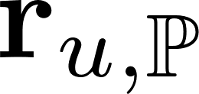
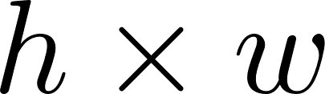


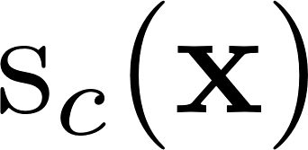

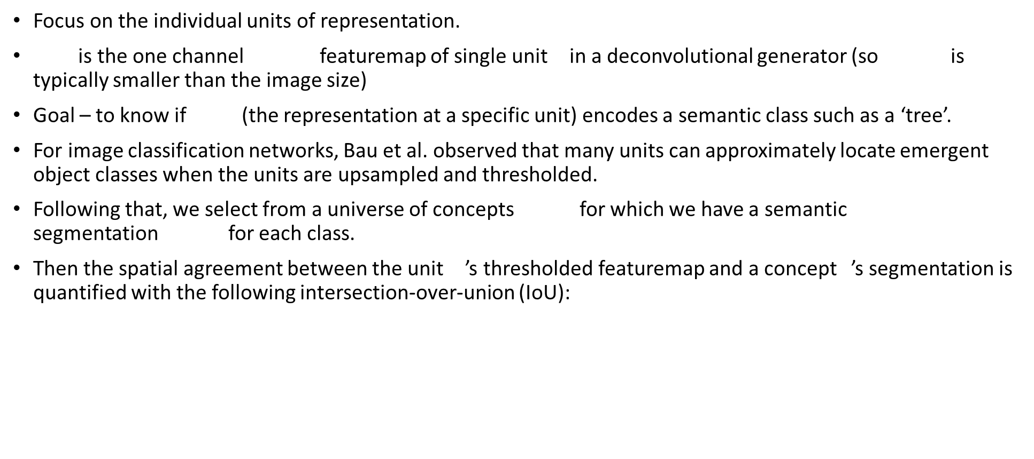
Identifying units by Dissection
Focus on the individual units of representation.
is the one channel (h x w) featuremap of single unit u in a deconvolutional generator (so hxw is typically smaller than the image size)
Goal – to know if (the representation at a specific unit) encodes a semantic class such as a ‘tree’.
For image classification networks, Bau et al. observed that many units can approximately locate emergent object classes when the units are upsampled and thresholded.
Following that, we select from a universe of concepts c$∈$ C for which we have a semantic segmentation for each class.
Then the spatial agreement between the unit u ’s thresholded featuremap and a concept c’s segmentation is quantified with the following intersection-over-union (IoU):

Slide 27
Interventions
After identifying an object class that a set of units match closely, we next ask: which units are responsible for triggering the rendering of that object?
A unit that correlates highly with an output object might not actually cause that output.
Furthermore, any output will jointly depend on several parts of the representation.
We need a way to identify combinations of units that cause an object

Slide 28
Intervention
Notes:
The difference in the amount of trees in the output when our variables are forced on, and when they are forced off, is called the “Causal Effect.”
We can test this over a large sample of images and quantify the results as the “average causal effect”.
As a detail, we can also force a single neuron on and off (that is, just one pixel of the featuremap) and measure its local effects as well.

Slide 29


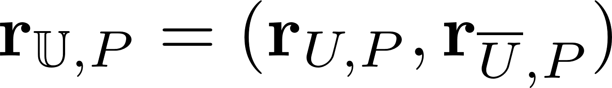

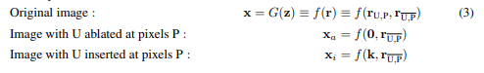
Measuring Casual Relationships using Intervention
A single unit generally isn’t enough to have a significant causal effect on the output
We want to find a set of units with high causal effect on the output of a specific class
We’d like to factor as where is the set of all units of
We ablate some units by forcing r_{U,P} = 0. We insert some units by forcing r_{U,P} = k, where k is a class-specific constant adjusting for the size of the class (object).
An object is caused by U if the object appears in x_{i} and disappears from x_{a} .
This casuality can be quantified by comparing the presence of trees in x_{i} and x_{a} and averaging effects over all locations and images.

Slide 30
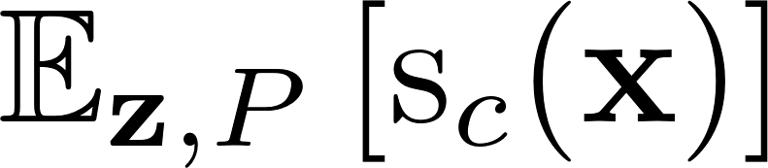

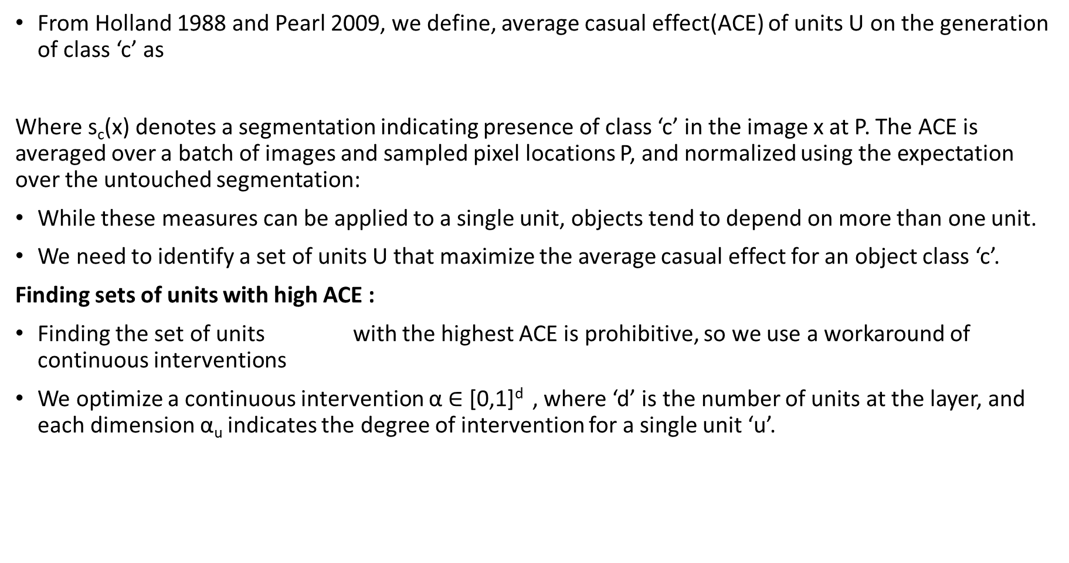
Intervention Details
From Holland 1988 and Pearl 2009, we define, average casual effect(ACE) of units U on the generation of class ‘c’ as
Where s_{c}(x) denotes a segmentation indicating presence of class ‘c’ in the image x at P. The ACE is averaged over a batch of images and sampled pixel locations P, and normalized using the expectation over the untouched segmentation:
While these measures can be applied to a single unit, objects tend to depend on more than one unit.
We need to identify a set of units U that maximize the average casual effect for an object class ‘c’.
Finding sets of units with high ACE :
Finding the set of units with the highest ACE is prohibitive, so we use a workaround of continuous interventions
We optimize a continuous intervention α $∈$ [0,1]^{d} , where ‘d’ is the number of units at the layer, and each dimension α_{u} indicates the degree of intervention for a single unit ‘u’.

Slide 31
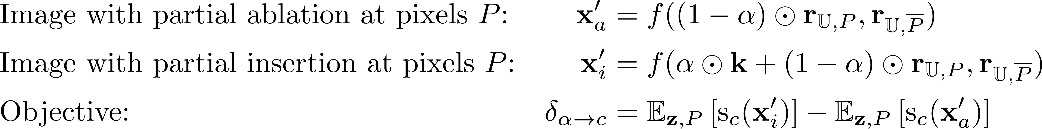
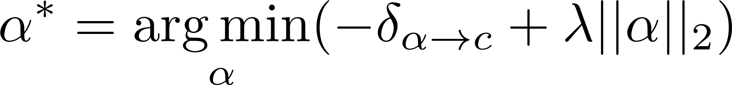
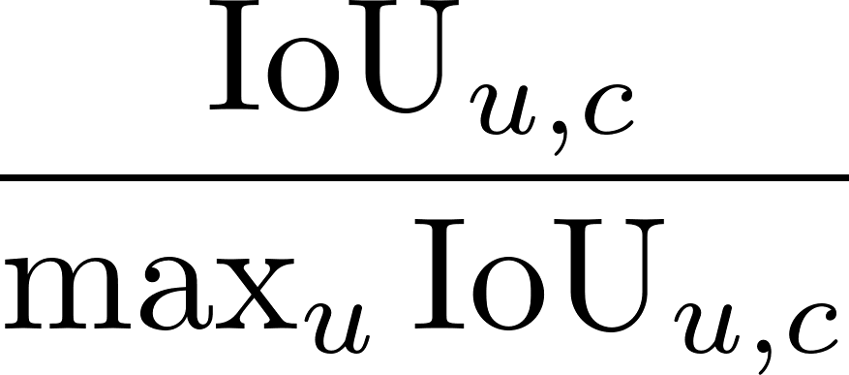
Intervention Details
Maximizing the following ACE formulation δ_{α->C}
α is optimized over the using the above loss with L2 regularization:
Where λ incentivizes a minimal size of the set of units.
α is initialized to
We optimize using stochastic gradient descent, sampling over both z and featuremap locations P and clamping the coefficient α within the range [0,1]^{d} at each step ( d is the total number of units).
Finally we rank units by α_{u}* and achieve a stronger casual effect(i.e., removing trees) when ablating successively large sets of tree-causing units.

Slide 32
Experiments and results
Three variants of Progressive GANs trained on LSUN scene datasets are studied.
To segment the generated images, a recent model( Xiao et al., 2018) trained on the ADE20K scene dataset(Zhou et al., 2017) is used.
The model can segment the input image into object classes, parts of large objects, and materials.
To further identify units that specialize in object parts, we expand each object class ‘c’ into additional object part classes c-t, c-b, c-l and c-r ( top, bottom, left or right half of the bounding box of a connected component)
We use dissection for analyzing and comparing units across datasets, layers and models and locating artifact units
Then we start with a set of dominant object classes and use intervention to locate causal units that can remove and insert objects in different images.

Slide 33
Comparing units across datasets, layers and models
Emergence of individual unit object detectors: Interested in any units that are correlated with instances of an object class with diverse visual appearances
Interpretable units for different scene categories: The set of all object classes matched by the units of a GAN provides a map of what a GAN has learned about the data
Interpretable units for different network layers: In classifier networks, the type of info explicitly represented changes from layer to layer. Similar phenomenon in GAN.
Interpretable units for different GAN models: Interpretable units can provide insights about how GAN architecture choices affect the structures learned inside a GAN. We examine
Baseline progressive GAN
A modification that introduces minibatch stddev stats
A further modification that adds pixel wise normalisation

Slide 34
GAN Dissection: Comparing Datasets
Top objects: ceiling, wall, person, table…
Scene: conference room
Notes:
What can we find by dissection? The first thing we notice is that the neurons that emerge inside a GAN generator are pretty relevant to the scenes on which it was trained. For example, a conference room generator will have a neuron for conference tables, another for persons, another for seats.
Actually it will have several units for each of the above. So to visualize the distribution of such concept-correlated units, the paper shows several graphs. Here you can see many units for ceilings, walls, persons, tables, seats, floor, etc.

Slide 35
GAN Dissection: Comparing Datasets
Top objects: ceiling, window, chair, table…
Scene: dining room
Notes:
Switching the set of training images will result in neurons that learn different things. In a dining room, windows and chairs are more prominent.

Slide 36
GAN Dissection: Comparing Datasets
Notes:
In a kitchen, we see work surfaces (countertops) and stove-tops.
In outdoor churches we get things like grass, tree, domes, and doors.

Slide 37
GAN Dissection: Comparing Models
SWD (Sliced Wasserstein Distance) [Karras, et al 2017]: the lower, the better
Notes:
We can also use dissection to get some intuition about the effect of training a GAN with different training methods.
Here we examine a progressive GAN trained without two of the key tricks introduced by Karras. This GAN was trained without minibatch statistics and without pixewisel normalization. You can see qualitatively that the images don’t look that great. You can also see what concepts are learned by individual units.

Slide 38
GAN Dissection: Comparing Models
SWD (Sliced Wasserstein Distance) [Karras, et al 2017]: the lower, the better
Notes:
Karras introduced a training method they call “minibatch standard deviations” where the discriminator gets access to simple second-order statistics over the sample. The justification is to try to avoid mode collapse.
Using dissection we can see that the effect is pretty pronounced: lots more concepts emerge in individual units, and also more units overall are good matches for concepts.

Slide 39
GAN Dissection: Comparing Models
SWD (Sliced Wasserstein Distance) [Karras, et al 2017]: the lower, the better
Notes:
Then Karras improves stability by adding “pixelwise normalization”. This continues to increase the number of units that match concepts well.
Each of the measurements of SWD is a measure of how realistic the output distribution is (it’s a comparison of the distance between image statistics of the synthesized distribution and those of the true distribution, so lower is better). The better models also have more units that match semantics.
In other words, it seems that these methods for improving the output of a GAN also improve its ability to recognize and compose images out of objects!

Slide 40
GAN Dissection: Comparing Layers
Hard to find object concepts
Notes:
Where are the objects represented in a GAN? We can dissect different layers of a GAN and compare the results.
Interestingly, the output of the first convolutional layer of a GAN does not have object concepts in individual units.
That’s not to say the information about objects isn’t in there. By definition, everything output by the GAN is derived from the representation, so the object information must be inside there. However, it’s not clearly represented at this layer. There are very few individual units that correspond to object concepts (just a couple units that seem to correlate with ceilings).

Slide 41
GAN Dissection: Comparing Layers
Objects and object parts
Notes:
In contrast, as you move down to layer 4 and beyond, you get a significant number of units that correlate well with objects and object parts.

Slide 42
GAN Dissection: Comparing Layers
Texture, color, edges
Notes:
Going further down reveals units that are more correlated with textures, colors, and edges.
This is a similar picture to what has been seen before in classification convnets, but in reverse. As you get near the end of the network, you get closer to the pixels, and the convolution channels are dealing in pixel-related details.
Earlier in the network the units are more concerned about high-level concepts. Interestingly, if you go back too early, the concepts vanish again.

Slide 43
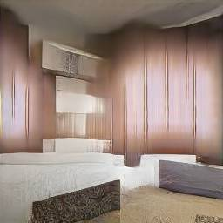
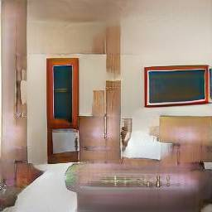
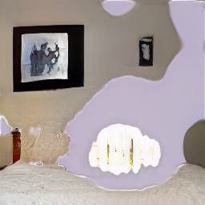
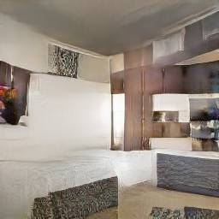

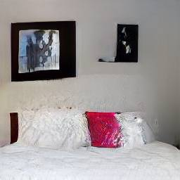
Debugging and Improving GANs
Unit #63
Bedroom images with artifacts
Unit #231
Example artifact-causing units
Ablating “artifact” units improves results
Notes:
Can any benefits come of the study of individual units?
Yes! We apply the idea towards debugging GANs. By examining the top-activating regions of units, we noticed that some units consistency activate on these buggy “artifact” image regions that are output occasionally.
Then interestingly, if you zero the top 20 such units and examine the modified output, the image quality improves! Here are a couple examples.
We have verified this improvement in a number of ways such as using FID and by polling AMT workers.
In the main paper the 20 artifact-causing units were found manually, but in the supplement we also describe a way to identify artifact-causing units by evaluating FID directly in a per-unit fashion by looking at a skewed distribution of generated images on which each individual unit fires the strongest.

Slide 44
Diagnosing and Improving GANs
This method can also be used to identify and ablate artifact-causing units
We can identify these units efficiently by human annotation: out of a sample of 1000 images, we visualize the top 10 highest activating images for each unit, and we manually identify units with noticeable artifacts in this set.
After ablating 20 artifact-causing units, the artifacts were removed from the output while the artifact-free pixels were unchanged.
Fréchet Inception Distance (FID) between the generated and real images is reduced (improved) after the artifact ablations.
1000 images were scored on Amazon MTurk collecting 20,000 human annotations comparing the modified image to the original. This metric also showed significant improvements in the artifact-ablated images.

Slide 45
Reasoning about contextual relationships using interventions
Errors and a variety of specific object types can also be removed from GAN output by ablating a set of units in a GAN.
By turning off the small sets of units, most of the output can be removed from the generated scenes by ablating. But not every object can be erased. Ablating those units will reduce the size and density of these objects, but will rarely eliminate them.
The ease of object removal depends on the scene type.
Difficulty of removal reflects the choice that a GAN has learned for a concept.
The same can be said for insertion of objects

Slide 46
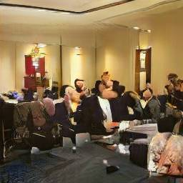

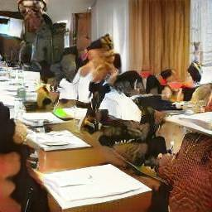

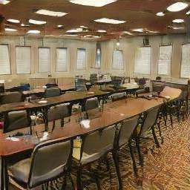


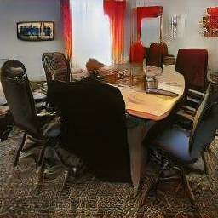
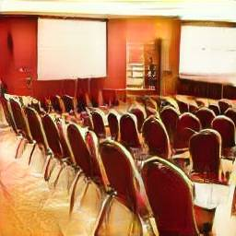
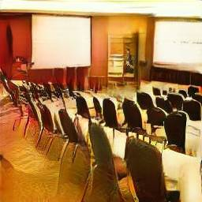
Object-Scene Relationship
ablate person units
ablate curtain units
ablate window units
ablate table units
ablate chair units
Notes:
Other things can also be removed from images, not just buggy artifacts.
For example, here we show the removal of various objects from conference rooms: people, curtains, windows, tables and chairs.
Each of the causal effects can be measured, and actually, we find that tables and chairs cannot be removed very easily from conference rooms. The measure of average causal effects is the portion of object pixels that are removed when 20 neurons are turned off.
So the interventions are providing some information about the structure of the model that the GAN has learned. It knows that people and windows and curtains are optional. But somehow, in a conference room, tables and chairs are less optional.

Slide 47


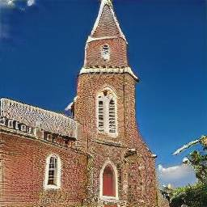
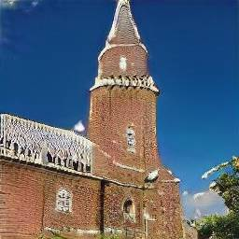
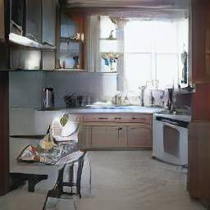
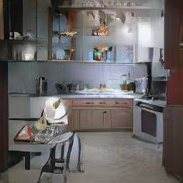




Object-Scene Relationship
conference room
church
kitchen
living room
bedroom
Notes:
Does the optionality of windows have to do with the pixels or the context? Looking at removal of windows in a bunch of different scene types, it appears that it has to do with the context. That is, windows are easy to remove from conference rooms, kitchens, and churches, but hard to remove from bedrooms or living rooms.
It seems that within a model of living rooms and bedrooms, windows are not very optional.
Did you know that modern building codes require bedrooms to have a window for fire safety reasons?
Somehow the GAN seems to have caught on to that pattern.

Slide 48










Object-Scene Relationship
Yellow bounding box: highlight every location where we can insert doors.
Notes:
Objects can also be inserted by activating neurons.
In this experiment, 20 door neurons are identified and activated. The exact same activation levels are used for a variety of featuremap pixels.
Those pixels where the intervention actually works are highlighted in yellow, and the results from an intervention are shown to the right.
Notice that even though the activation is the same in each case, the doors that are output look very different, and are sensitive to context, with different sizes, shapes, colors, and materials.
The other interesting thing is that calling for a door in the wrong location will result in very little changes in the image. The graph shows that while you can insert a door in a brick wall in a building, or in the location where many windows are, you can’t insert a door in the sky.

Slide 49
Discussion and ideas
Many parts of GAN representations can be interpreted, not only as signals that correlate with object concepts but as variables that have a causal effect on the synthesis of objects in the output.
These interpretable effects can be used to compare, debug, modify and reason about a GAN model.
Potentially applied to other generative models such as VAEs(Kinma and Welling,2014) and RealNVP(Dinh et al., 2017)
Focused on the generator rather than the discriminator because the generator must represent all the information necessary to approximate the target distribution, while the discriminator only learns to capture the difference between real and fake images.

Slide 50
Discussion and ideas
Uncovered many questions that cannot be answered yet, with the current method
Why can a door not be inserted in the sky.
How does the GAN suppress the signal in the later layers
Further work will be needed to understand the relationships between the layers of a GAN
Could this method be adapted to span multiple layers?
The early layers in a generator appear much more entangled than the later layers in a classifier, would this be any different in a class-conditional GAN?

Slide 51
Thank You!
Questions?
Source : Adapted from http://gandissect.csail.mit.edu/

